Slide 1
Welcome to HMIS 202
Advanced User Training

Slide 2
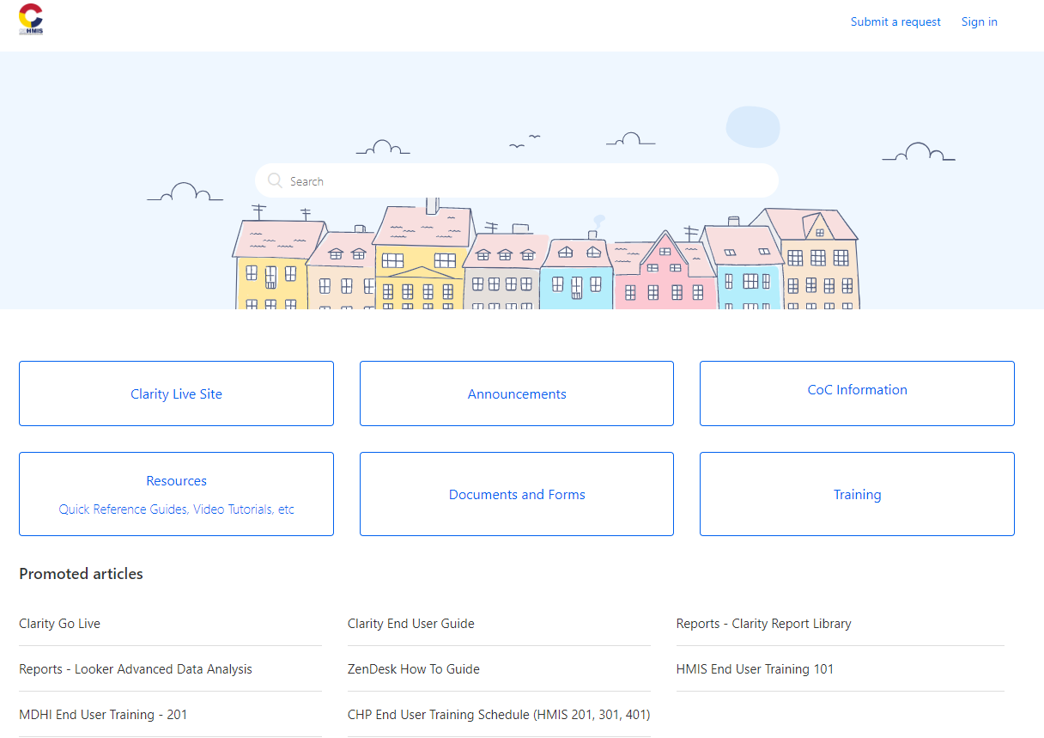
Hmis support resources
Cohmis.Zendesk.com
Notes:
Let’s start with an intro to your support center, Zendesk, which can be found at cohmis.Zendesk.com.
If you’re and existing HMIS you should be familiar with the Training button. Additional videos and written guides can be found on the Resources button. If you need to ask a question, you should click on Submit a Request. If you want to review the result if a previous request, you can sign in to view your history. A full tutorial on how to use Zendesk is available in the form of the ZenDesk How To guide, conveniently located as a promoted article on the home page. If you were on a different page and need to get back to the home screen, click on the COHMIS emblem on the top left corner of your web page.

Slide 3
Navigation overview
Messages
Avatar
Agency name
Launchpad
Search=Home
Notes:
A quick recap of the home screen: make sure you are logged in as the correct agency, launchpad will give you access to other applications like attendance and reporting, messages within Clarity are secure and preferred over email when discussing client data, clicking on Avatar will allow you to sign out and change your password.
To get back to this screen, click the Search button with the magnifying glass.

Slide 4
Searching for clients
First three letters of the first and last name
SSN (requires dashes)
Alias
Birth date (requires slashes)
Do not search both Alias and legal name
All other search terms are mix and match
Notes:
The search bar has a predictive suggestion box that will populate as you type so you can add more detail as needed until you find the person you’re looking for. I find that last name and last four of ssn is usually enough information to find what I’m looking for. You can also search by unique ID or by scanning the clients’ id into the search bar.

Slide 5
Client Profile
1 2 3
Client name displays in upper left corner
Client level tabs
Right panel activities:
Print client level reports
Set an appointment
Access privacy settings/ ROI
Manage household
View active programs
View recent services
4
5
6
Notes:
Note that the tabs across the top are highlighted when selected, with a bar underneath to show you which tab is currently active.

Slide 6
The profile tab
Demographic information
Unique ID
Notes:
Please take note of the unique ID

Slide 7
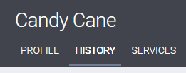
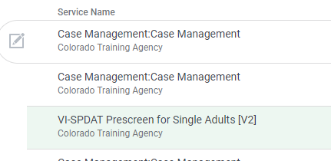
The Client history tab
Shared across agencies
Can view all history, but edit only your own programs
Service notes are visible to others
Case notes are not, if done correctly

Slide 8
Reviewing attendance history
Notes:
To look at a clients’ bed night history, go to the History tab, then click the edit button next to the appropriate service. On the edit screen, scroll all the way down- the history will be at the bottom of the page.

Slide 9
The programs tab vs the right side panel
Notes:
You can select the program you want to manage by going to the programs tab, or by clicking on the right side panel. Both of these methods have “invisible” edit buttons that will allow to you click once you have hovered your mouse over the program name.

Slide 10
The Client notes TAB
For CLIENT LEVEL notes only
Client notes will populate to all members of your agency
Public alerts will populate to all HMIS users with a yellow alert bar on the client profile
This notes tab is not for service related or case management notes!

Slide 11
The client Contact Tab

Slide 12
Adding contact information
Client contacts only
Email and/or phone
Don’t delete contacts!

Slide 13
The client Location tab
Notes:
The client location tab works just like the contact tab. Click add address and fill out the form.

Slide 14
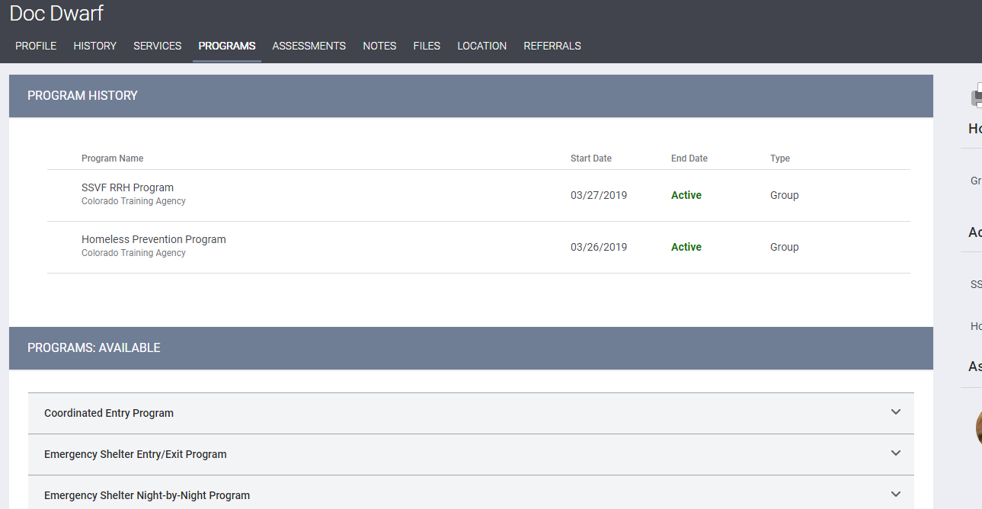
Enrolling Clients into programs
1
Make sure you are on HOH’s profile
1-Click the programs tab
2-Choose the program
3-Toggle the appropriate household members
4-Click Enroll
2
3
4

Slide 15
Emergency shelter tracking types
Night by night
Entry-Exit
Allows one enrollment to cover multiple short term stays
Must record a service for each night stayed
Date of Engagement
When the client is engaged in a plan to resolve their homelessness
Current Living Situation
recorded every time client receives services beyond basic human needs
Do not need to document service for each bed night
MUST exit when no longer staying at shelter
MUST provide new enrollment if they come back after a gap in stay
Do not need to record date of engagement or current living situation

Slide 16
The program tabs

Slide 17
The program Panel
Reassign case manager
Change head of household
View and add household members

Slide 18
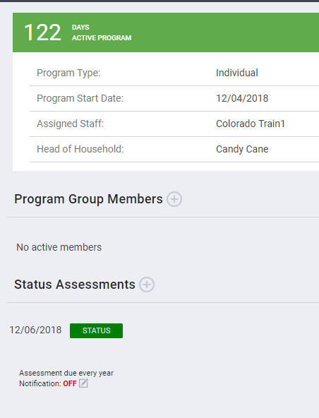
The program enrollment tab
Stores all information from original enrollment
Should only be accessed to make corrections to original program enrollment
Should NOT be used to enter changes effective after enrollment date
Use the Assessments tab or Status Assessments on the right side bar instead
Exception: Date of Engagement

Slide 19
The Program History tab
Shows history of services provided for one program at a time

Slide 20
The program services tab
Notes:
The services menu works the same way the program enrollment does, click on the intended service to expand the menu.

Slide 21
Providing a service
Record services provided to client
Notes entered here are visible across agencies
Each service has slightly different fields to enter e.g. Expense Amount for deposit assistance or Time Tracking for case management
Don’t forget to click submit!

Slide 22
Attendance/ Group services

Slide 23
Adding to the attendance “Bucket”
Notes:
You can add to the bucket in several different ways. You can locate in the the “Clients from last X time” list, you can search for them in the bar to the right, or you can scan their Clarity id card (make sure your cursor is in the search field). If you are entering late arrivals after midnight, don’t forget to change the date on the calendar, the default will always be today’s date.

Slide 24
The program assessments tab
This is where changes are reported (not the Enrollment tab!)
Current living situation is also here if applicable to your program

Slide 25
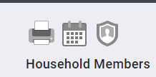
The program notes tab
These notes are not shared across agencies
Printing a case notes report
Go back to client profile
Click printer icon
Run Case Notes report

Slide 26
The program files tab
Not shared with other agencies
Program specific documents- lease agreements, behavior plans, etc.

Slide 27
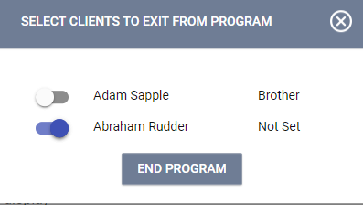
The program exit tab
Click Exit
Choose members
Fill out exit questionnaire
Most answers will be auto filled from most recent assessment
Made a mistake? Forgot a service? Go back to exit and delete the date to reopen the record for editing.

Slide 28
Questions?

